Slide 1

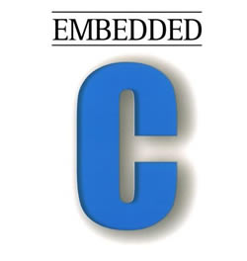
“Advanced C Programming”

Slide 2
4. Functions

Slide 3
Functions
Definition: A function is a self-contained program segment that carries out some specific, well-defined task.
Every C program consists of one or more functions.
Function should be declared or prototyped before it is being used anywhere
One of these functions must be called “main” * (conditions apply)
Function will carry out its intended action whenever it is called.
Input
Function - Computations
Output

Slide 4
Defining a Function
Function Definition: A function definition has two principal components:
the first line - Return type, Function Name, Parameters or Arguments
the body of the function
Every C program consists of one or more functions.
Syntax:
return_type function_name( parameter list )
{
body of the function
}

Slide 5
Function Prototypes
Function Declaration: A function declaration tells the compiler about a function name and how to call the function.
Parameter names are not compulsory, but data types must be mentioned.
Syntax:
return_type function_name( parameter list );
Function Call: To use a function, you will have to call that function to perform the defined task.
When a program calls a function, program control is transferred to the called function.
A called function performs defined task and when its return statement is executed

Slide 6
Function prototypes…
Function prototype at the beginning of C code:
describe what the function returns and what it takes as input
Prototype should be followed by semicolon
Parameter list is optional
Default return type is integer
Example:
double max( double param1, double param2) { if (param1 > param2) { return param1; } else { return param2; } }
Examples:
float sqrt( float ); int maximium( int , int );

Slide 7
Return type of a C Function
Every C function must specify the type of data being generated by the function.
If the function does not generate any data, its return type can be “void”.
The type of expression returned must match the type of the function, or be capable of being converted, otherwise we can see undefined behaviour.
Example:
void print_happy_birthday( int age ) { printf("Congratulations on your %d th Birthday\n", age); return; }

Slide 8
Functions - Example
Example:
#include <stdio.h>
long int facrorial( int ); → Function prototype
int main()
{
int n; long int fact;
fact = factorial( n ); → Function Call
printf(“Factorial of %d is %ld”, n, fact);
return 0;
}
long int factorial( int n ) /* calculate the factorial of n */
{
int i;
long int prod = 1;
if (n > 1)
for (i = 2; i <= n; ++i)
prod *= i;
return(prod);
}
Actual Argument
Formal Argument

Slide 9
Function Parameters - Rules
The number of arguments in a function call must be the same as the number of parameters in the function definition. This number can be zero.
The max no. of arguments is 253 for a single function. (Machine dependent)
If a function is called with arguments of the wrong type, the presence of a prototype means that the actual argument is converted to the type of the formal argument ‘as if by assignment’. If prototype is not present then it may give garbage values or undefined behaviour.
In the old style, parameters that are not explicitly declared are assigned a default type of int.
The scope of function parameters is the function itself. Therefore, parameters of the same name in different functions are unrelated.

Slide 10
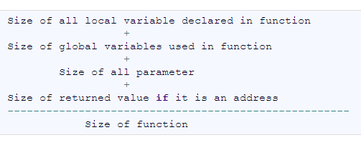
Functions - Rules
Function Declaration: A function declaration tells the compiler about a function name and how to call the function.
C program can have one or more functions.
Any function can be called from any function
A function can be called any number of times.
A function can call itself.
A function cannot be defined in another function.
Size of a function

Slide 11
Functions with no arguments No return value
#include<stdio.h>
void area(); // Prototype Declaration
void main()
{
area();
}
void area()
{
float area_circle;
float rad;
printf("\nEnter the radius of circle : ");
scanf("%f",&rad);
area_circle = 3.14 * rad * rad ;
printf("Area of Circle = %f",area_circle);
}

Slide 12
Functions with arguments No return value
#include<stdio.h>
void area(float rad);
void main()
{
float rad;
printf("nEnter the radius : ");
scanf("%f",&rad);
area(rad);
}
void area(float rad)
{
float ar;
ar = 3.14 * rad * rad ;
printf("Area of Circle = %f",ar);
}

Slide 13
Functions with arguments with return value
#include<stdio.h>
float calculate_area(int);
int main()
{
int radius;
float area;
printf("\nEnter the radius of the circle : ");
scanf("%d",&radius);
area = calculate_area(radius);
printf("\nArea of Circle : %f ",area);
return(0);
}
float calculate_area(int radius) {
float areaOfCircle;
areaOfCircle = 3.14 * radius * radius;
return(areaOfCircle);
}

Slide 14
Functions - Advantages
Advantages:
Modularity
Readability
Reusability
Easy to develop, debug and test
Allows test-driven development
Allows unit testing
Allows top-down modular approach

Slide 15
Function Parameters
Parameters are the symbolic name for "data" that are passed to a function
Formal Arguments - Called function
Actual Arguments - Calling function
Two ways that arguments can be passed to a function:
Call by value
Copy of data is sent to the function being called
Doesn’t affect the original data
Call by Reference
Reference to the data is sent
Reference parameter "refers" to the original data in the calling function.
Changes affect the original data
void swap(int x, int y)
// call by value
Swap(x,y);
void swap( int *x, int *y)
//call by reference
Swap( &x, &y);

Slide 16
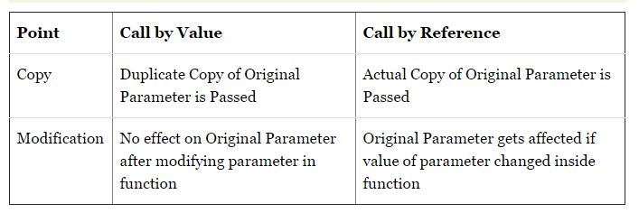
Function Parameters…
void swap(int x, int y)
// call by value
Swap(x,y);
void swap( int *x, int *y)
//call by reference
Swap( &x, &y);

Slide 17
What is the Value of the a and b ?
void swapping(int c, int d)
{
Int tmp;
tmp = c;
c = d;
d = tmp;
printf("In function: %d %d\n", c , d);
}
Void main( )
{ int a,b;
a=5; b=10;
printf("input: %d %d\n", a, b);
swapping(a,b);
printf("output: %d %d\n", a, b);
}

Slide 18
What is the Value of the a and b ?
void swapping(int *ptr_c, int *ptr_d)
{ int tmp;
tmp = *ptr_c;
*ptr_c = *ptr_d;
*ptr_d = tmp;
printf("In function: %d %d\n", *ptr_c , *ptr_d); }
Void main( )
{
int a,b;
a=5;
b=10;
printf("input: %d %d\n", a, b);
swapping(&a,&b);
printf("output: %d %d\n", a, b);
}

Slide 19
Recursion
Definition: Recursion is a process by which a function calls itself repeatedly, until some specified condition has been satisfied.
To solve a problem recursively
The problem must be written in a recursive form.
The problem statement must include a stopping condition.
A recursive function must have the following type of statements :
A statement to test and determine whether the function is calling itself again.
A statement that calls the function itself and must be argument.
A conditional statement (if-else).
A return statement.

Slide 20
Recursion
Syntax:
A()
Void A()
{
if (stopping condition)
return;
else
A();
return;
}
void main()
{
A();
return;
}

Slide 21

Recursion – Example1 - Factorial
Can we compute factorial using recursion?
factorial(5) = 5 * factorial(4)
4 * factorial(3)
n
3 * factorial(2)
2 * factorial(1)
n - 1

Slide 22
Recursion – Example1 - Factorial
Example: Recursive function to find factorial
int main()
{
long int fact;
printf(“Enter n value:”);
scanf(“%d”, &n);
fact = fact(n);
printf("Factorial=%ld", fact);
return 0;
}
long int fact(int f)
{
if (f==1 || f==0)
return 1;
return (f*fact(f-1);
}

Slide 23
Working of Recursion
Long int fact(4)
{
if (f==1) { return 1; }
return (4*fact(3));
}
Fact(3) returns 6
Long int fact(3)
{
if (f==1) { return 1; }
return (3*fact(2));
}
Long int fact(2)
{
if (f==1){ return 1; }
return (2*fact(1);
}
Fact(2) returns 2
Long int fact(1)
{
if (f==1){ return 1; }
return (1*fact(0);
}
Fact (1) Returns 1

Slide 24
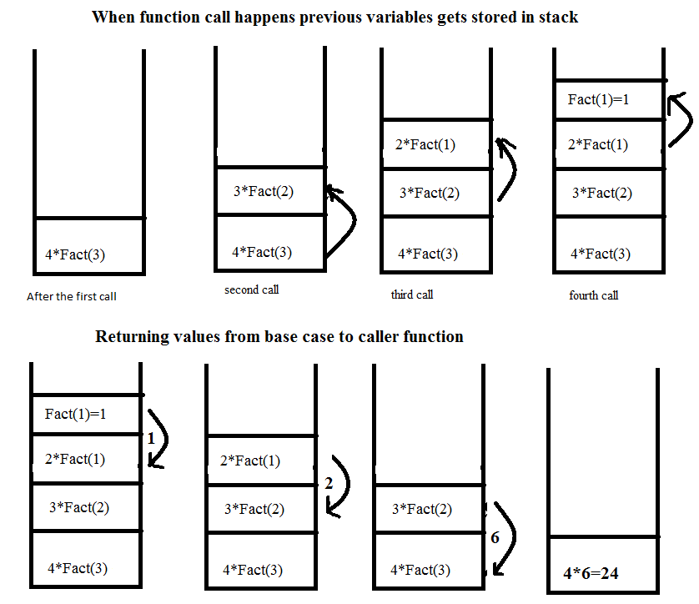
Recursion – Example1 - Factorial
How it works?

Slide 25
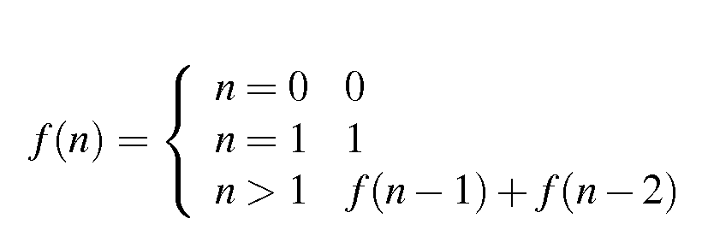
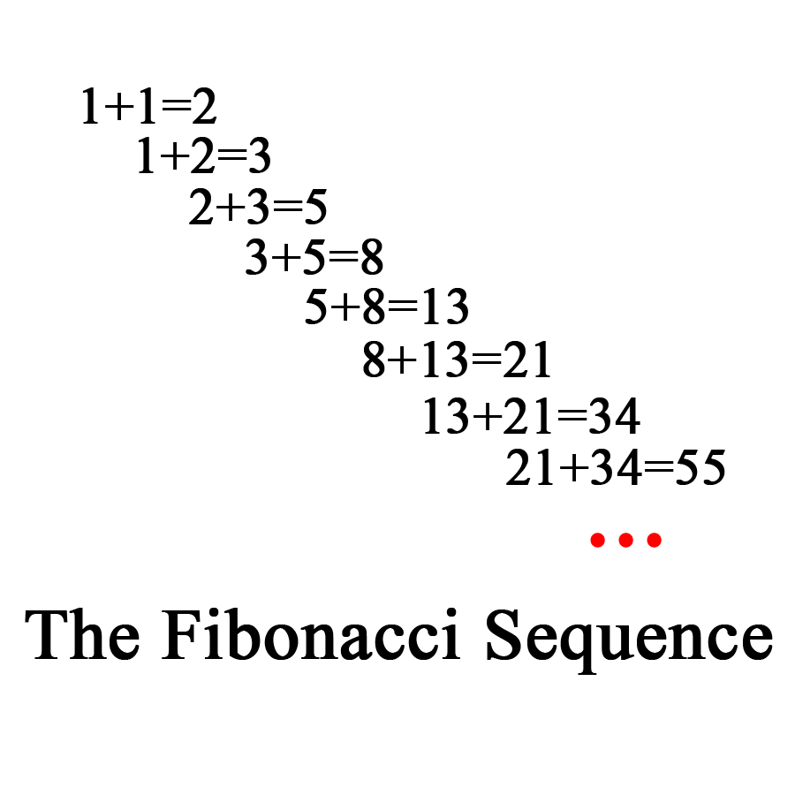
Recursion – Example2 - Fibonacci
Can we compute Fibonacci series using recursion?
Do it Now: Write a program to find ‘n’ Fibonacci numbers using recursion

Slide 26
Recursion – Example2 - Fibonacci
#include<stdio.h>
int main()
{
int i;
for (i = 0; i < 10; i++)
printf("%d\t", fibonacci(i));
return 0;
}
int fibonacci(int i)
{
if(i == 0) return 0;
if(i == 1) return 1;
return (fibonacci(i-1) + fibonacci(i-2));
}

Slide 27
Recursion
Advantages:
Simple to code (Not Always)
Size of the code will be less
Readable
Disadvantages:
Difficult to understand in some algorithms
Stack Overflow in case of deep recursion
Less portable
Writing parallel recursive functions is error prone

Slide 28
Class room Exercise - 6
Write a program to implement multiplication using addition. Use recursion.
2. Write a program to swap two numbers.
3. Write a recursive function to find the sum of n
integers.

Slide 29
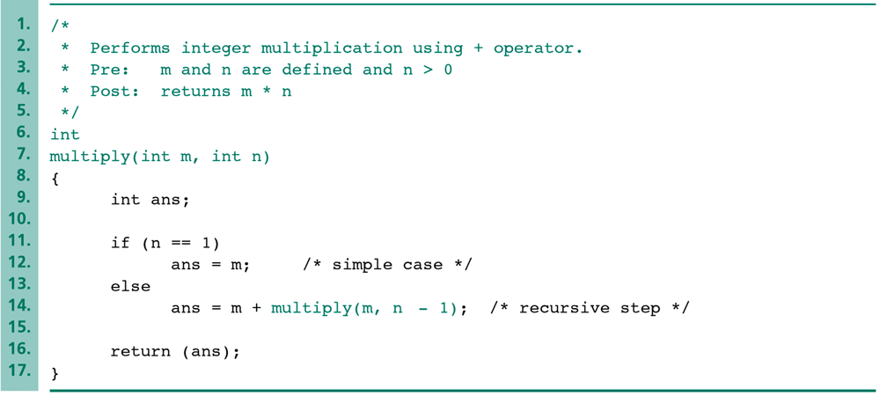
Class room Exercise - 6

Slide 30
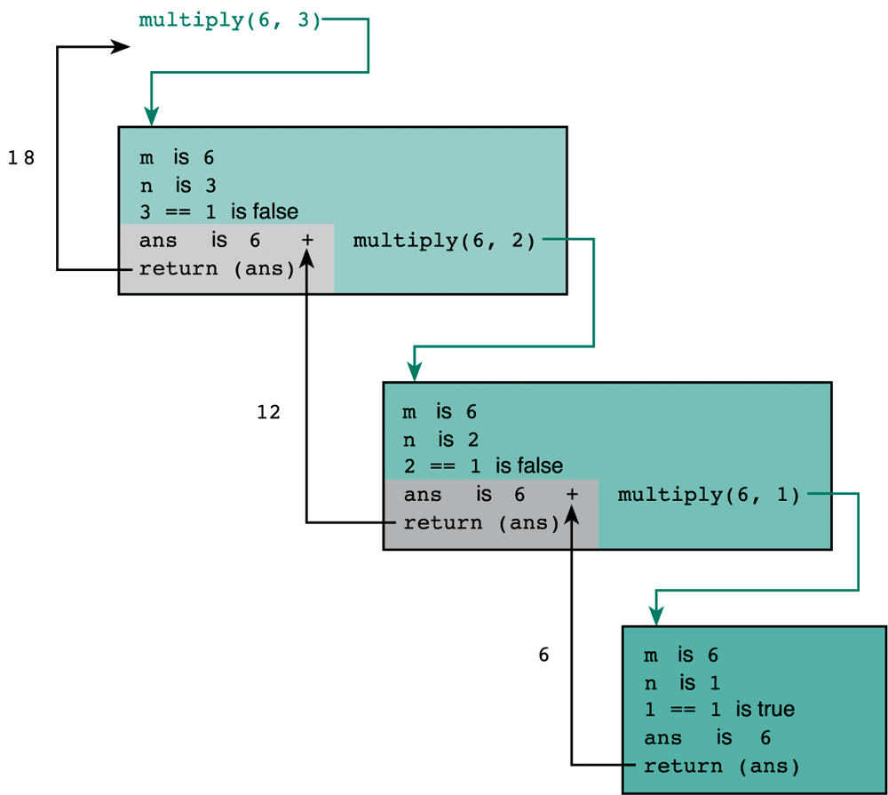
Trace of Function multiply(6,3)
The recursive step.
The recursive step.
The simple case.
Ref: 2004 Pearson Addison-Wesley.

Slide 31
Thank You

